Slide 1
Social Innovation Policies in the Basque Country
Summer School Bologna
Álvaro Luna García
(Sinnergiak Social Innovation (UPV/EHU))

Slide 2
Index
Background Context
Basque Innovation System
Basque Science and Technology Network
Social Innovation in the Basque Country

Slide 3
Background-context
Institutional complexity:
3 Historic provintial governments: Biscay, Gipuzkoa, Alava
251 municipalities
One Autonomous Regional Government
2.189.000 inhabitants
7.234 KM2

Slide 4
Background-context
The first steps on the rise of the Basque innovation system are strongly conditioned by the crisis in the manufacturing sector starting in the 1980s and stretching all the way to 1995.
Industrial activities were traditionally centred on steel and shipbuilding; activities that decayed during the economic crisis of the 1970s and 1980s, giving ground for the development of the service sector and new technologies.
The Basque Country has a long tradition of industrial planning, translated into a long term regional development and innovation strategy. The lack of R&D in the traditional industry was object of a strong political support to increase the innovation in manufacturing industry. Since early eighties a long-term strategy has guided the transformation from traditional industry based economy towards knowledge intensive society with the support of the innovation system agents

Slide 5
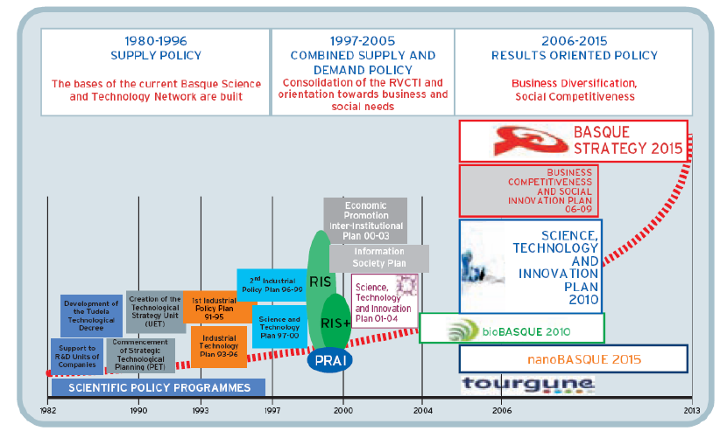
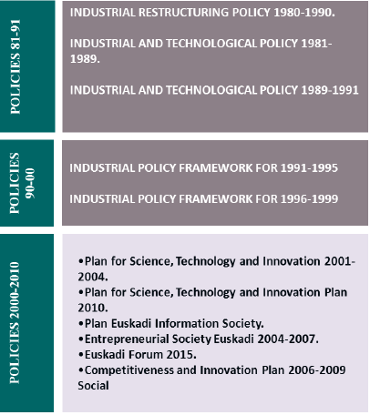
Background-context

Slide 6
Background-context
Policies in innovation focus on technological development of companies:
Strong division between technology policy (Department of Industry of the Basque Government) and Science Policy (Department of Education) on its initial beginnings.
Prevalence of industrial concerns
R&D system is strengthened mainly in industrial-technological dimension and in lower extent in the academic-scientific side

Slide 7
Basque System of Science Technology and Innovation
BASQUE COUNCIL OF SCIENCE
TECHNOLOGY AND INNOVATION
SCIENCE POLICY
STRATEGIC RESEARCH
TECH. & INNOVATION POLICY
IKERBASQUE
SPRI
SCIENTIFIC EXCELLENCE
UNIVERSITARY SYSTEM
COOPERATIVE RESEARCH
TECHNOLOGY CORPORATIONS
ENTREPRENEURIAL SYSTEM
BERCs
UPV-EHU
U.DEUSTO
M.U.
CICs
TECNALIA
IK4
CLUSTERS
TECHNOLOGICAL PARKS

Slide 8
BASQUE SYSTEM OF SCIENCE TECH. AND INNOVATION
BASQUE COUNCIL OF SCIENCE TECHNOLOGY AND INNOVATION
LEHENDAKARI-PRESIDENT BASQUE COUNTRY
Departments of Treasury, Health and Education
General Deputy’s from the 3 Historic Provintial Gov.
Rectors of the three universities
Tecnalia Tech. Corp.
IK4-Tech. Corp.
Ikerbasque (Basque Science Foundation)
Innobasque (Basque Innovation Agency)
R&D Sectors and main company representatives
Jakiunde (Academy of Science and Arts)

Slide 9
BASQUE SYSTEM OF SCIENCE TECH. AND INNOVATION
SUBSYSTEM
TECHNOLOGY AND INN. POLICY
SPRI-SOCIETY FOR THE INDUSTRIAL RECONVERSION
BASQUE Government Entreprenurial Development Agency since 1981
200 employees
Supports and impulses the basque entreprenurial sector.
Manages 70% of the budget of the Department of Economic Development and Competitiveness of the Basque Country
Oriented to support SME’s:
INTERNATIONALIZATION: 59 countries
ENTREPRENEURSHIP: Support programs
ICT’s: Training and digitalization programs
INNOVATION: Programs to support people and management
FUNDING: Loans, risk capital

Slide 10
BASQUE SCIENCE, TECH. AND INNOVATION NETWORK
At the beginning of the 21st century there is a rethinking about the R&D system
An attempt to overcome the traditional division between science policy and industrial policy and the lack of articulation of the system
Institutional proliferation connecting basic and applied research and attempting to increase coordination of the system
CIC´s
BERC´s
Ikerbasque
Innobasque
Research and technological development is moving in a complex system with several agents grabbing traditionaly academic functions: RVCTI (NETWORK)

Slide 11
BASQUE SCIENCE, TECH. AND INNOVATION NETWORK
The Basque Science, Technology and Innovation network is a well-established practice within the Basque strategy. The origins of the network are due to the initial efforts of the Regional government to build the science and technology infrastructure to situate the Basque Country region in better productivity trajectory.
Based on the Science, Technology and Innovation Plan (PCTI 2015), Innobasque’s actions concerning the Basque Science, Technology and Innovation Network consist of:
Fostering effective co-ordination and collaboration of all agents in the fields of science, technology and innovation.
To facilitate interaction between agents in the Basque Science, Technology and Innovation System and to articulate the demands of the production fabric with the skills in the system

Slide 12
BASQUE SCIENCE, TECH. AND INNOVATION NETWORK

Slide 13
SOCIAL INNOVATION IN THE BASQUE COUNTRY
Social innovation has been a continuum in The Basque Country, and has been developed from different perspectives and agents through the creation of public value:
Mondragon Cooperative
Social and Urban Transformation of the Metropolitan Area of Bilbao
Ikastolas- Educational Cooperatives promoted By parents and teachers to preserve Basque language and culture

Slide 14
SOCIAL INNOVATION IN THE BASQUE COUNTRY
Business Competitiveness and Social Innovation Plan 2006/09
Vision:
Transformation of the Basque Country in a reference
node inside the global innovation system.
Raising the competitiveness of its organizations and
quality of life standards of its citizens
Social Innovation becomes an strategic axis for the
sustainable economic development and the social
cohesion of the Basque Territory

Slide 15
SOCIAL INNOVATION IN THE BASQUE COUNTRY
Social innovation has entered in the public agenda tightly related to public innovation policies and new initiatives to foster a social open innovation model.
During the last (2010-17) years there has been a considerable increase of Social Innovation private and public agents in the Basque Country working in different stages of the social innovation value chain: analysing social reality, knowledge generation, social transformation, dissemination and training.
Promoting SI in the Basque Country has been and important goal where public and private cooperation have been crucial
In 2013 the Basque Innovation Agency –Innobasque– creates the Basque Social Innovation Platform (BSI)

Slide 16
SOCIAL INNOVATION IN THE BASQUE COUNTRY
Basque Social Innovation is a node or experimental platform working on Social Innovation in the Basque Country, consisting of more than 20 social innovation agents. The Basque Social Innovation is the first consortium for social innovation created at regional level in Europe.
Key organizations:
The 3 universities of the Basque Region: UPV–EHU (University of the Basque Country and Agirre Lehendakari Center, University of Deusto and Deusto Social Innovation, Mondragon University
Technology Centres such as Tecnalia and financial institutions such as KutxaBank
SMEs: Social Innovation Park, Business Innovation Brokers, ColaboraBora, Servicios Sociales Integrados,
Policy makers: Basque Government, the Provincial Governments of Bizkaia, Gipuzkoa and Araba, and the municipalities represented by EUDEL (Association of Basque Municipalities.
Social agents: trade unions CC.OO. And UGT, Basque Business Confederation (Confebask)
Nonprofit sector(third sector): EHLABE, REAS, Fundación Novia Salcedo

Slide 17
SOCIAL INNOVATION IN THE BASQUE COUNTRY
Social Innovation in the RIS3 Strategy included in the Basque Smart Specialization Strategy
(Basque Plan of Science, Technology and Innovation 2020)-reflects and addresses
key societal challenges:
Evaluation and socioeconomic impact of SI
Support of Good Practices of SI in the Basque Country
Support of cooperation and social entrepreneurship, especially in the following areas:
ageing population, education and life-long learning, employment, work place
innovation
Increase presence in European Project to transform the Basque Country into an
important node of SI in Europe

Slide 18
SOCIAL INNOVATION IN THE BASQUE COUNTRY
Social Innovation is included the RIS3 Strategy Basque Smart Specialization Strategy
(Basque Plan of Science, Technology and Innovation 2020)-reflects and addresses
key societal challenges:
Evaluation and socioeconomic impact of SI
Support of Good Practices of SI in the Basque Country
Support of cooperation and social entrepreneurship, especially in the following areas:
ageing population, education and life-long learning, employment, work place
innovation
Increase presence in European Project to transform the Basque Country into an
important node of SI in Europe

Slide 19
CONCLUSIONS
Drivers
Institutional support
Entrepreneurial initiative
Network of Agents
Human Capital
Social Capital- Auzolan
Barriers
Low Connectiveness
Limited innovation capacity
Scarce technological development
Low culture of innovation

Slide 20
Introducing the Social Innovation Community (SIC)
29th June 2017

Slide 21
SIC will engage, strengthen and connect existing social innovation networks and projects, funded by the European Commission

Slide 22
SIC is a Horizon 2020 project, which over the next three years aims to create a network of networks in the field of social innovation.
Our aim is to make the field of social innovation in Europe more than the sum of its parts. Funded by the European Commission and run by a consortium of 12 leading organisations across Europe, SIC will engage, strengthen and connect existing social innovation networks.

Slide 23
How it works
WP1: Engagement and Dissemination
WP2: Research
WP3: Experimentation
WP4:Learning
WP5: Policy
WP6: Strategy Development and Impact Measurement
WP7: Project Management

Slide 24
How it fits together

Slide 25
What we will do over the next three years
WP1: Engagement and Dissemination
This WP is critical to the overarching success of the project. The overarching aim is to curate and co-ordinate the SIC networks to create an inclusive and dynamic social innovation community that engages a broad and diverse range of stakeholders.
WP2: Research
This WP aims to support the emergence of an inclusive social innovation research community which transcends European. Building on existing networks, this WP aims to further advance the field of social innovation as a whole in theory and practice.

Slide 26
What we will do over the next three years
WP3: Experimentation
The overall objective of this WP is to conduct high impact experiments and test new models of cross-sector and transnational collaborations in addressing locally defined issues and challenges. It aims to create a platform for sharing inspiring potential solutions, with a strong potential for replication, adoption or scaling up
WP4: Learning
Realising the full potential of social innovation requires a systematic approach to developing a SI learning framework. This WP will connect dispersed practices, experiences and actors across Europe and will co-create and share a common understanding of learning as fundamental for the diffusion of a new SI culture.

Slide 27
What we will do over the next three years
WP5: Policy
The overall objective of this WP is to increase understanding about how social innovation can contribute to meeting the policy objectives of the European Union and its Member States, and to increase the relevance and effectiveness of public policy related to social innovation.
WP6: Strategy Development and Impact Measurement
The overall objective of this WP is to develop, implement and constantly update the strategic, governance and assessment frameworks for the social innovation networks. This WP will also measure and showcase social innovation impact.
WP7: Project Management This WP defines and implements the overall coordination, administrative, technical, financial, quality, risk, legal and ethical issues related to the project.

Slide 28
The SIC Networks
Cities and regional development
Collaborative and sharing economy
Community-led innovation
Corporate social innovation
Digital social innovation
Inclusive development
Intermediaries
Public sector innovation
Social Economy

Slide 30
Make sure you stay up to date!

Slide 31
The SIC consortium

Slide 32
Stay in touch! You can sign up to networks and regular updates at: www.siceurope.eu
aluna@sinnergiak.org Follow us: @SICommunity_EU

